Slide 1
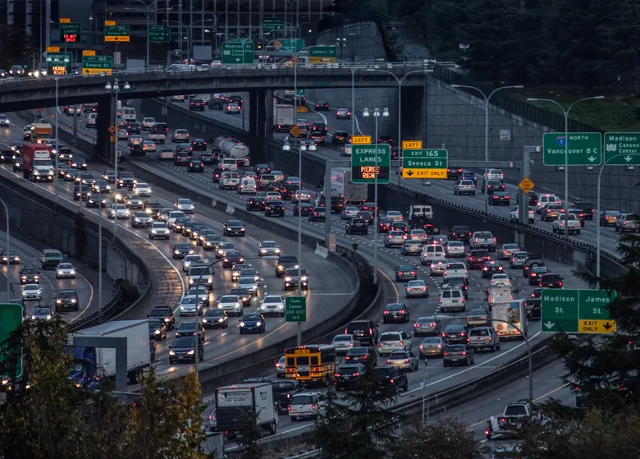
Short-Term Traffic Flow Prediction for Seattle’s I-5 Corridor
DATA 5100 – Foundations of Data Science
Team:
Hannah Belville
Cong Ho
Paul Skentzos
GitHub Repository: https://github.com/belvilleh/group_project
Image source: “Seattle’s I-5 bottleneck is 17th worst in nation, study says”, The Seattle Times, 11/24/2015, URL: https://www.seattletimes.com/seattle-news/transportation/seattles-i-5-bottleneck-is-17th-worst-in-nation-study-says/

Slide 2
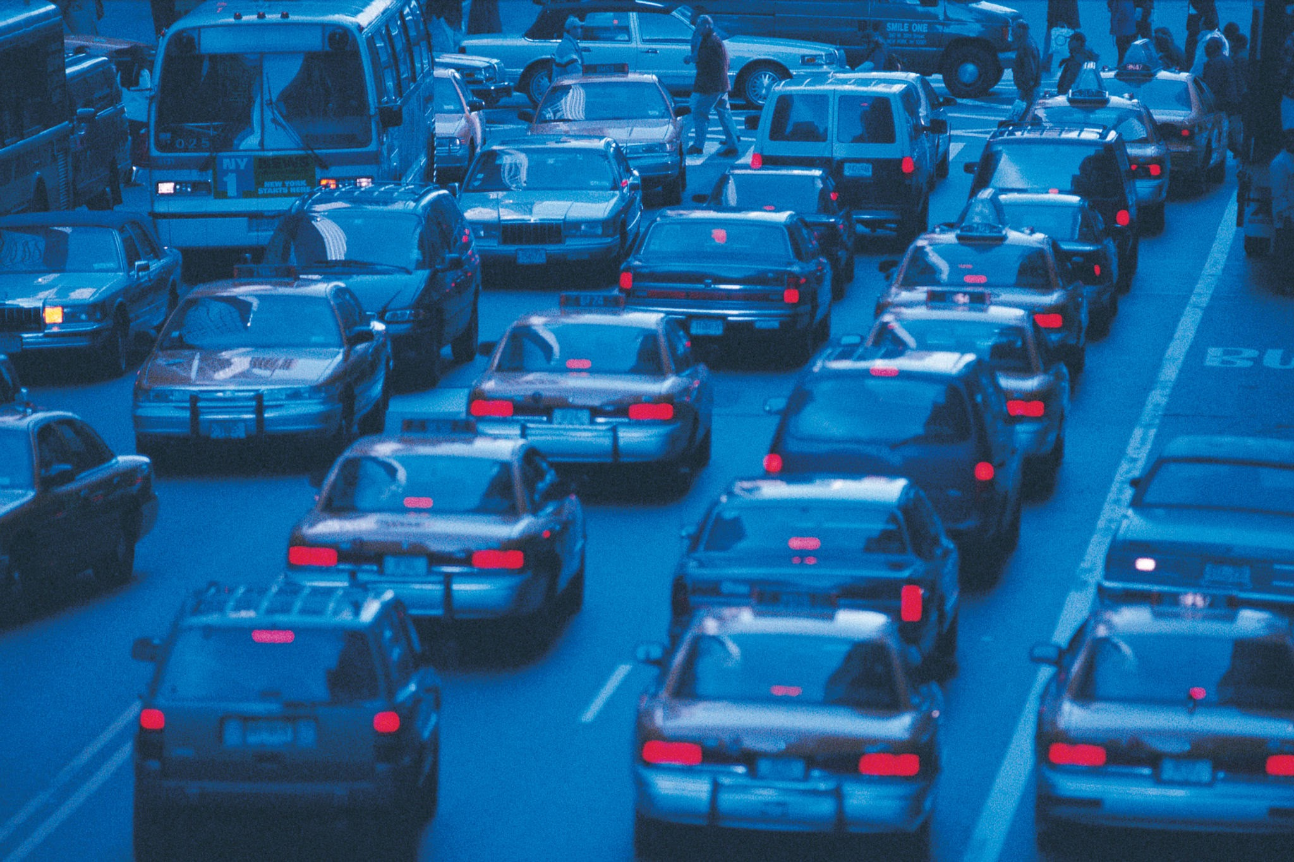
Introduction: Project Context
The Problem:
Seattle’s I-5 corridor experiences heavy congestion, creating delays and uncertainty for commuters and freight.
Goal of Project:
Forecast hourly traffic volume (flow) one hour ahead to support proactive traffic management.
Key Question:
Can we accurately predict next-hour traffic volume using historical sensor data, weather, and collision information?

Slide 3
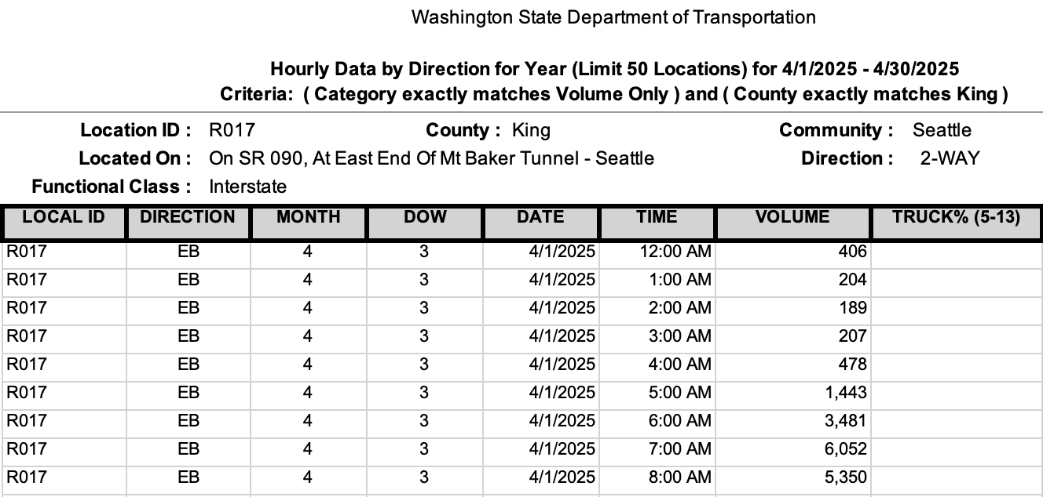
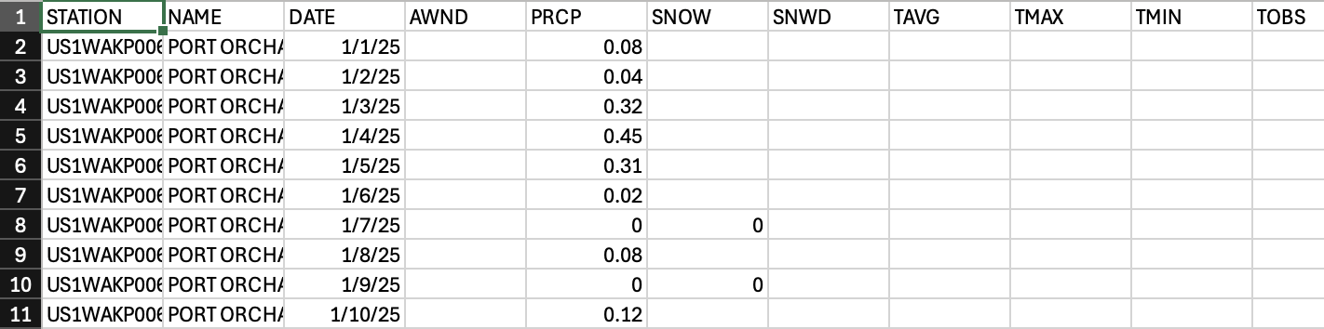
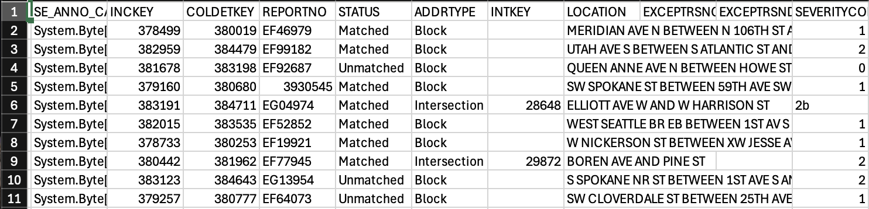
Types of Data Used
🚗
🚗
Traffic Volume Data
Data Modalities
Traffic Volume Data: Numeric time-series
Weather Data: Temperature, precipitation, snow
Collision Data: Hourly incident counts
Dataset Size
~1 year of data
105+ traffic sensors
100+ individual Excel files merged
Sources
Washington State DOT (WSDOT)
NOAA Climate Data
Seattle Open Data Portal
☀️
🌧️
Weather Data
🚗
💥
Collision Data

Slide 4

Data Collection & Quality
How Data Were Collected
WSDOT roadway sensors record volume every hour
NOAA stations collect weather measurements daily/hourly
SDOT logs collision reports with timestamps
Data Quality Considerations
Missing values across multiple sensors
Occasional malformed timestamps (e.g., “24:00”)
No personal information collected → privacy preserved
No human subjects → informed consent not required

Slide 5
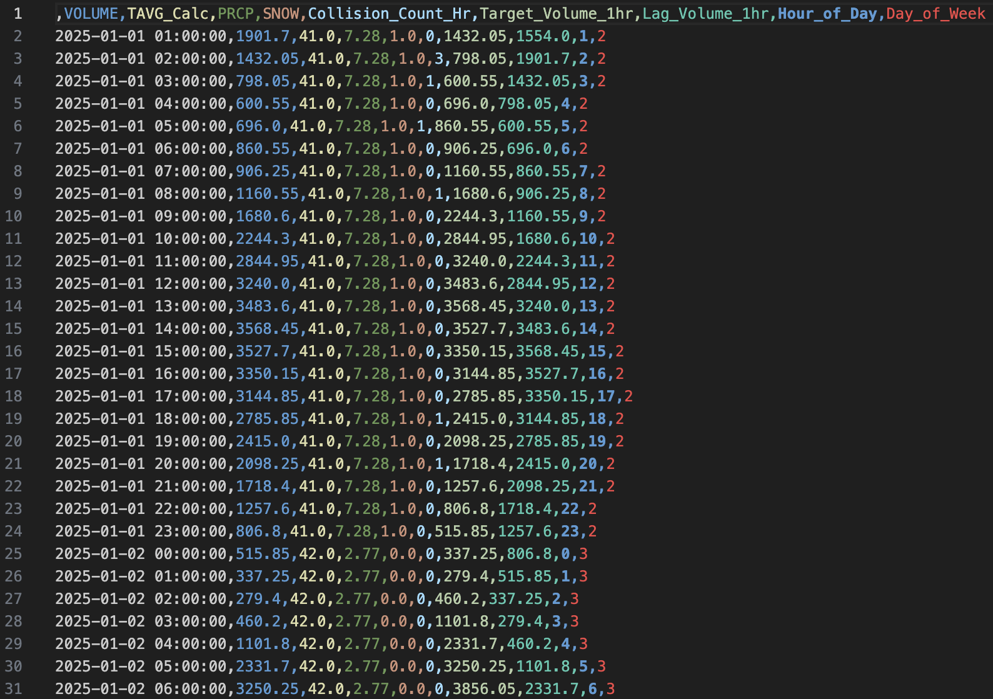
Data Processing Pipeline
Steps We Performed
Standardized column formats across 100+ Excel sheets
Identified valid DATE/TIME/VOLUME columns
Fixed invalid “24:00” timestamps
Interpolated missing volume values (linear interpolation)
Merged weather + collision datasets on timestamp
Constructed final unified hourly dataset

Slide 6
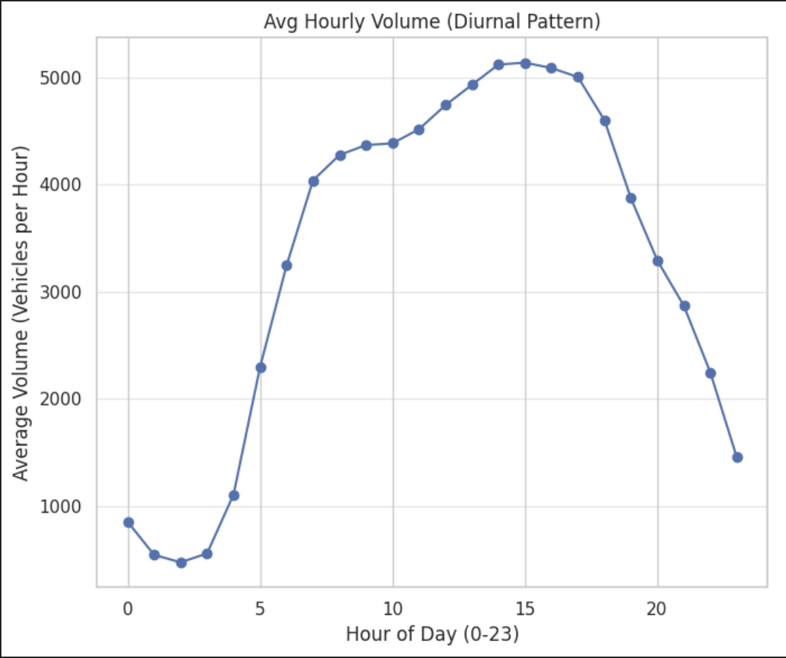
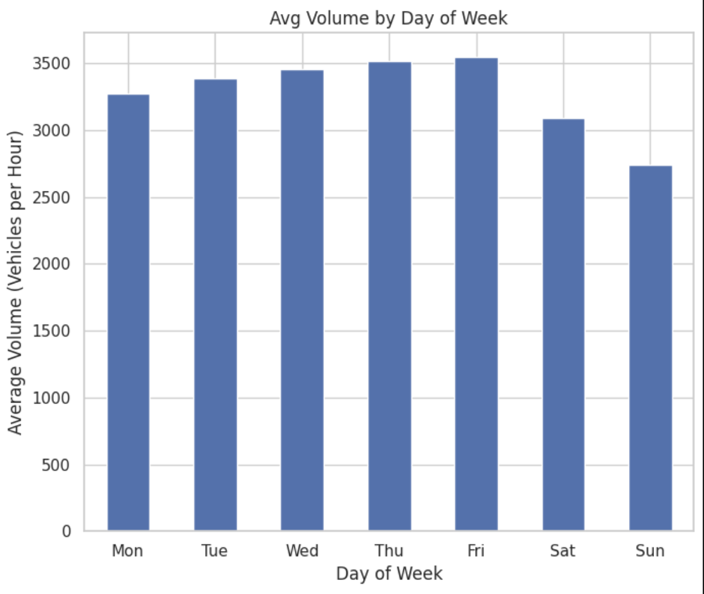
Exploratory Data Insights
Daily Traffic Cycle
Clear morning and evening peaks
Low volume overnight
Weekly Pattern
Higher volumes on weekdays
Lower traffic on weekends
Weather Relationships
Small correlation with precipitation
Snow events show sharper drops in volume
Collision Patterns
Collisions rare; limited predictive value

Slide 7
Analytical Approach Overview
Type of Problem
Supervised Machine Learning • Regression
Target Variable (y)
Target_Volume_1hr = traffic volume at time t+1
Feature Set (X) Includes:
Lag volume (Volume at t−1)
Hour of day
Day of week
Temperature (TAVG), precipitation (PRCP), snow (SNOW)
Number of collision per hour

Slide 8
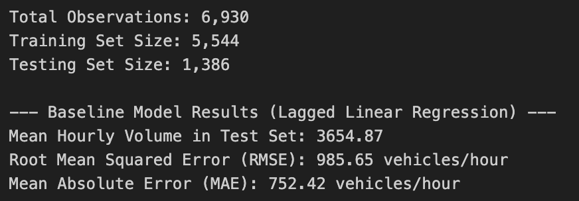
Baseline Model: Lagged Linear Regression
Model Form Example:
y(t+1) = β₀ + β₁·Volume(t−1) + β₂·Hour + β₃·DayOfWeek
Purpose of Baseline
Establish minimum acceptable performance
Assess predictability from volume alone
This baseline uses the full feature set (all 7 features), not just lag volume.
Performance Summary
RMSE = 985.65
MAE = 752.42

Slide 9
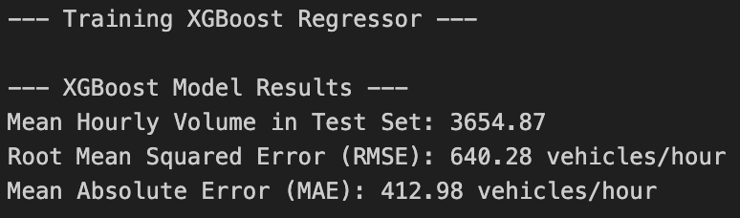
XGBoost Model
Why XGBoost?
Handles nonlinear patterns
Performs well with noisy real-world data
Automatically learns complex relationships
Model Inputs
Full engineered feature set
Hyperparameters Tuned
n_estimators
max_depth
learning_rate
subsample
colsample_bytree

Slide 10
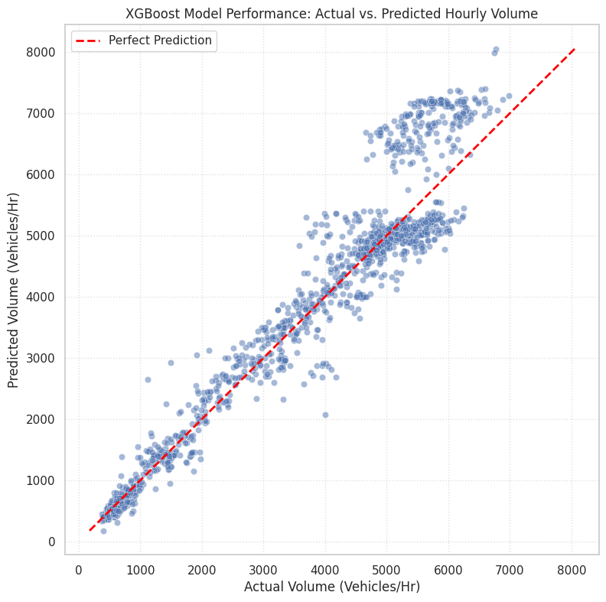
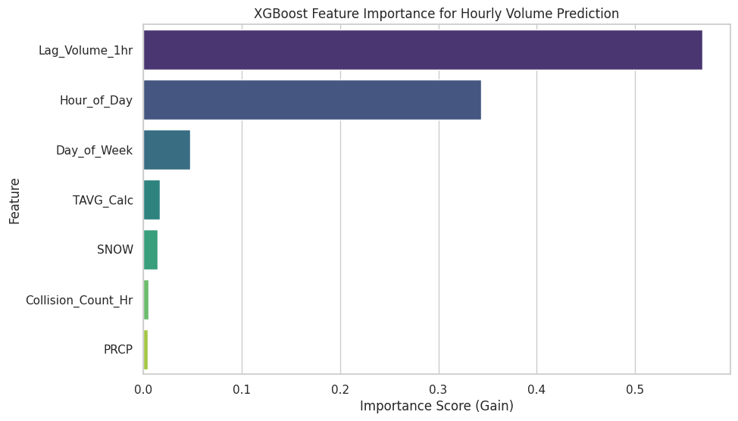
Final Tuning XGBoost Results
Performance
RMSE: ~591 vehicles/hour
MAE: ~399 vehicles/hour
Interpretation
Captures daily patterns effectively
Struggles during sudden events or spikes
Slight “prediction shift” due to using lagged features

Slide 11
Prophet Forecasting Model
Purpose of Testing Prophet
Prophet is a time-series forecasting model designed for seasonality and trend decomposition.
We tested it as an alternative to machine learning models to see whether its structure fits hourly traffic data.
Features Used
y (target volume)
ds (timestamp)
Regressors added: TAVG_Calc, PRCP, SNOW, Collision_Count_Hr
Performance
RMSE: 1903.17
MAE: 1722.15
Interpretation
Prophet struggled with short-term hourly forecasts.
Seasonal patterns exist, but strong hour-to-hour variation made Prophet underperform.
Results confirm that traffic volume behaves more like a nonlinear ML problem than a smooth seasonal time-series problem.
The 1-hour-ahead prediction window and availability of lag features favor tree-based models like XGBoost over decomposition-based forecasters like Prophet.

Slide 12
Model Performance Comparison
Model | RMSE | MAE | Notes
Lagged Linear Regression | 985.65 | 752.42 | Simple baseline
XGBoost (Untuned) | 640.28 | 412.98 | Handle nonlinearity, weather features
XGBoost (Tuned) | 549.17 | 368.66 | Best model
Prophet Forecasting | 1903.17 | 1722.15 | Struggles with volatile hourly data

Slide 13
Conclusion
Final Answer to the Research Question
Yes — machine learning models, especially XGBoost, can reasonably forecast next-hour traffic volume on the I-5 corridor using historical volume, time-of-day features, and weather.
Key Takeaways
Volume is highly time-dependent
Lag features are extremely predictive
Weather adds slight value
Collision impact minimal in short-term forecasting
Limitation
Noise in raw sensor volume data
Long gaps or missing sensors
Weather and collision data coarse or sparse
Harder to predict sudden congestion changes
Future Work
LSTM or attention-based deep learning
Multi-step forecasting (2–3 hours ahead)
Real-time incident integration
Additional explanatory variables (events, holidays)

Slide 14
References
WSDOT – Washington State Department of Transportation. Traffic Sensor Data (Volume & Flow). Retrieved from: https://wsdot.wa.gov/travel/real-time-traffic-data (Used as the primary traffic volume dataset across 100+ sensors.) WSDOT (2023). Congestion Prediction Research & Constraints. Used for understanding roadway prediction limitations and the importance of short-term forecasting. | NOAA – National Oceanic and Atmospheric Administration. Climate Data (Daily & Hourly Weather Records). Retrieved from: https://www.ncei.noaa.gov/cdo-web/ (Temperature, precipitation, and snow variables used as weather regressors.) Seattle Open Data Portal. Traffic Collision Dataset. Retrieved from: https://data.seattle.gov/ (Used to generate Collision_Count_Hr as an exogenous feature.)

Slide 15


